Slide 1


Online Learning Platform using MERN Stack
TEAM ID : NM2024TMID00577
Team members:
SRIKRISHNA S (311421104312)
VIKIRA ADITYA R S (311421104108)
VISHNU VARDHAN K(311421104315)
SANTHOSH KUMAR D (311421104311)
JAGAN R(311421104304)

Slide 2

TABLE OF CONTENTS
ABSTRACT
EXISTING SYSTEM
PROPOSED SYSTEM
PURPOSE
SCOPE
INTRODUCTION TO MERN STACK
TECHNICAL ARCHITECTURE
KEY FEATURES
ARCHITECTURE OF MERN STACK
ER DIAGRAM
USER ROLES AND RESPONSIBILITY
PROJECT STRUCTURE
PROJECT EXECUTION SCREENSHOTS
FUTURE ENHANCEMENT
CONCLUSION

Slide 3

ABSTRACT
The Online Learning Platform (OLP), built on the MERN stack (MongoDB, Express, React, Node.js), is a user-friendly solution for global education. It features course management, interactive tools, multi-device accessibility, secure user authentication, and payment integration. OLP empowers students with flexible learning, peer interaction, and certifications while supporting instructors and administrators in content and system management.
.

Slide 4

EXISTING SYSTEM
Traditional learning platforms often lack interactivity and flexibility.
Limited scalability and high operational costs for educational institutions.
Inconsistent user experience across devices and platforms.
Minimal support for real-time communication or adaptive learning paths.
No centralized system for managing students, instructors, and content.

Slide 5
PROPOSED SYSTEM
A MERN stack-based platform ensuring efficient front-end, back-end, and database integration.
Centralized online system offering flexible, self-paced learning experiences.
Interactive features: Forums, live webinars, and real-time messaging for better engagement.
Cross-device compatibility for seamless access on PCs, tablets, and smartphones.
Secure authentication and role-based access for students, instructors, and admins.
Personalized learning paths powered by adaptive algorithms.
Scalable and cost-effective architecture with third-party integrations for payments and video content delivery.

Slide 6


PURPOSE
Provide a flexible, global platform for self-paced learning and certification.
Enable easy course enrollment, progress tracking, and engagement through interactive tools.
Streamline content creation for instructors and offer admin control over platform management.

Slide 7
SCOPE
User Management
Course Management
Interactivity
Roles for students, instructors, and admins.
Creation, organization, and publishing of course content.
Discussion forums, webinars, and live chats.
Progress Tracking & Certification
Payment Options
Cross-Device Access
Support for paid courses and subscriptions.
Available on multiple devices.
Monitor progress and issue certificates.
Admin Panel
Monitor activity and manage platform tasks.

Slide 8
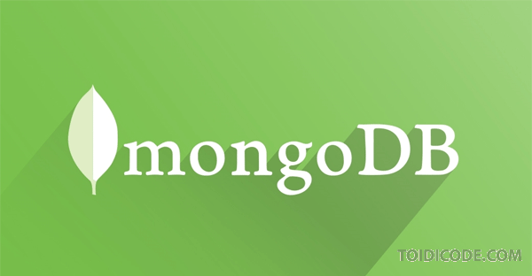
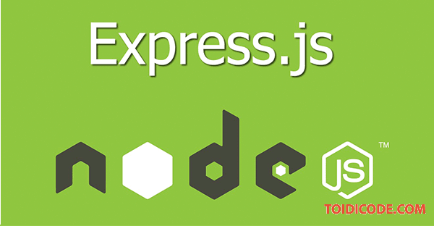
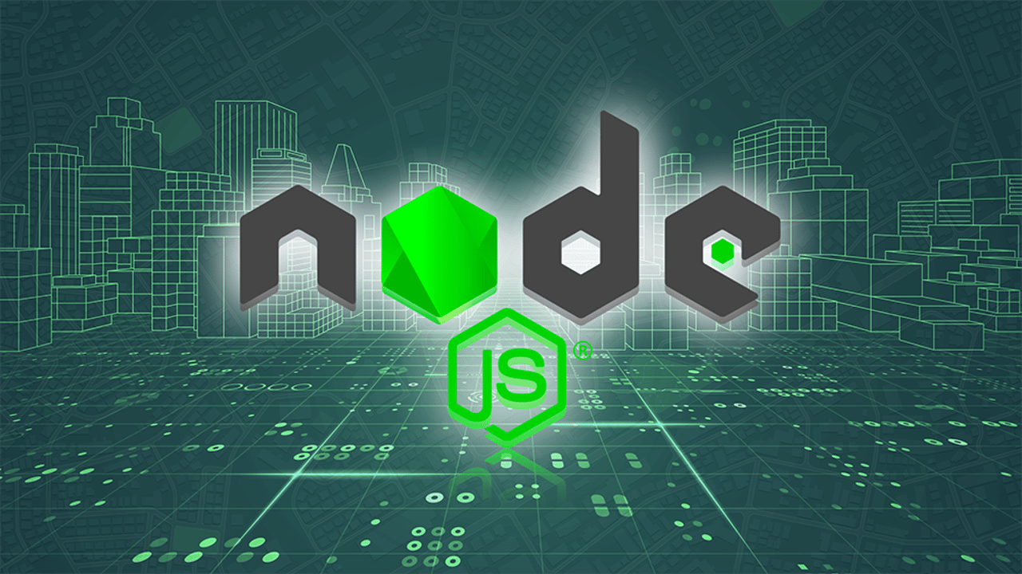
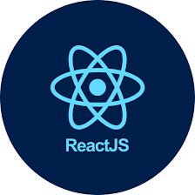
INTRODUCING THE MERN STACK
MongoDB
Express.js
React.js
Node.js
A NoSQL database ideal for handling dynamic and scalable data structures, such as user profiles, courses, and learning materials.
A declarative JavaScript library for building user interfaces, providing a flexible and efficient way to create interactive learning experiences.
A JavaScript runtime environment that powers the server-side of the application, allowing for efficient and scalable backend operations.
A robust and versatile Node.js framework for building server-side logic, handling API requests, and managing data interactions

Slide 9
TECHNICAL ARCHITECTURE
Front-End
Back-End
Built using React, Bootstrap, and Material UI for a dynamic, responsive UI. Axios connects to the back-end via RESTful APIs.
Powered by Express.js to handle server-side logic, with MongoDB for scalable data storage.
Communication & Security
Features & Integrations
RESTful APIs ensure smooth data exchange. JWT (JSON Web Tokens) secures access with role-based permissions (students, instructors, admins).
Real-time chat and messaging enable interaction. Third-party payment gateways support premium content, and video streaming handles course delivery.

Slide 10
KEY FEATURES
User Management
Course Management
Interactivity Tools
Supports registration, login, and profile management for students, instructors, and administrators.
Instructors can create, update, organize, and publish course materials, including video lectures, assignments, and reading materials.
Offers discussion forums, chat rooms, and live webinars to foster communication between students and instructors.

Slide 11
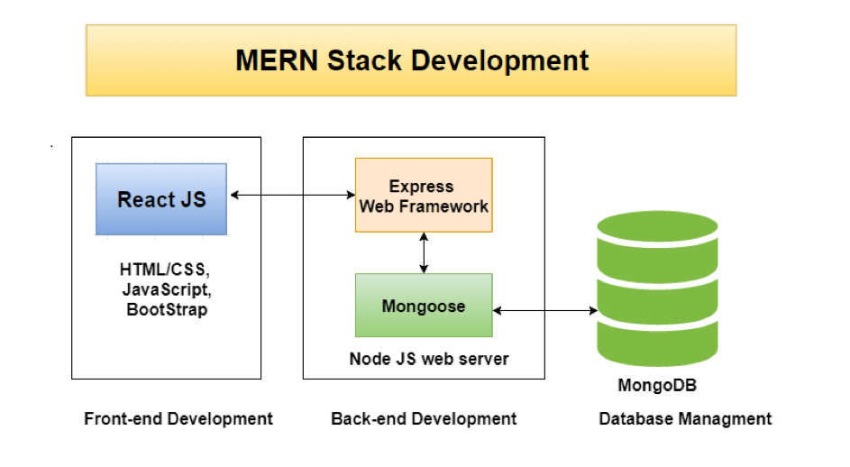
ARCHITECTURE OF MERN STACK

Slide 12
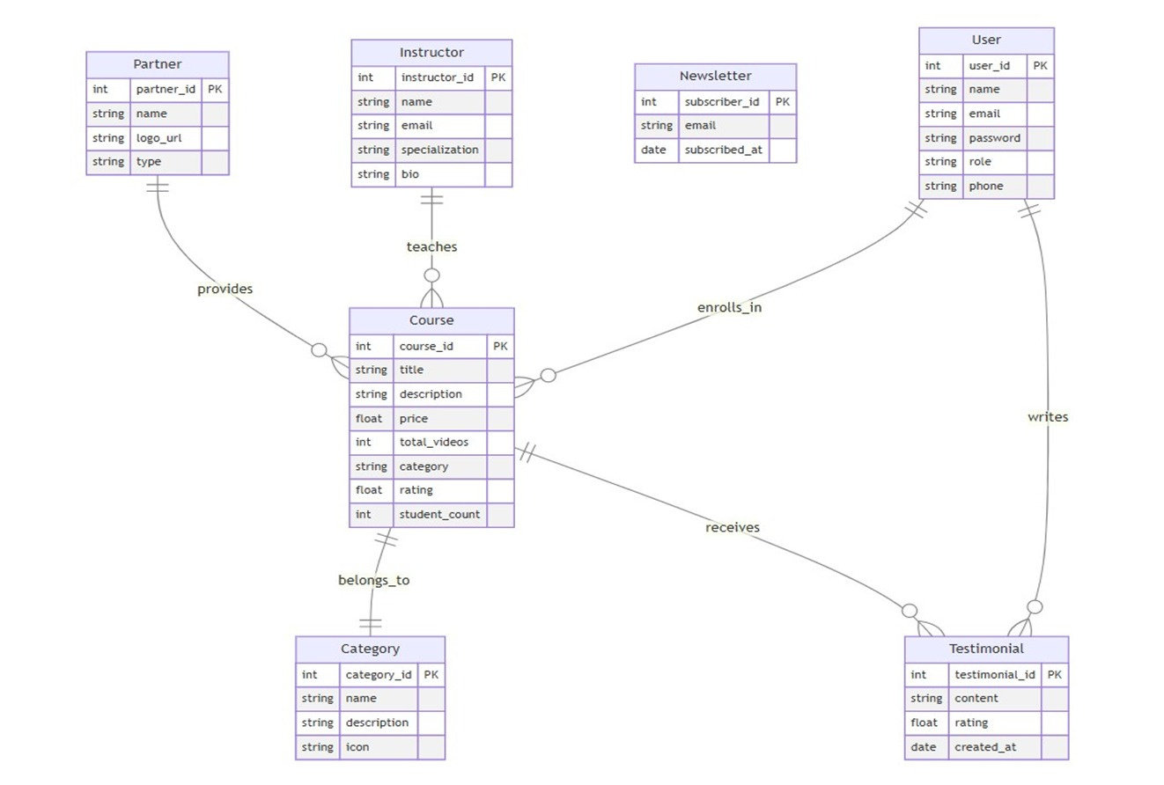

ER DIAGRAM

Slide 13



USER ROLES AND RESPONSIBILITIES
TEACHER
STUDENT
ADMIN
ADD COURSES
DELETE COURSES
ADD COURSE SECTIONS
ENROLL IN COURSES
TRACK PROGRESS
DOWNLOAD CERTIFICATES
SEARCH FOR COURSES
MANAGE COURSES
MONITOR USER ACTIVITY
HANDLE PLATFORM MAINTENANCE

Slide 14
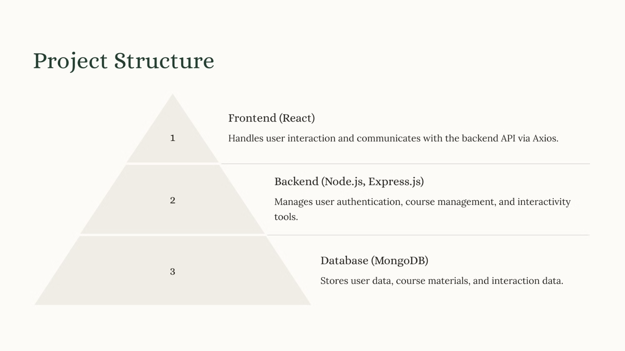

Slide 15
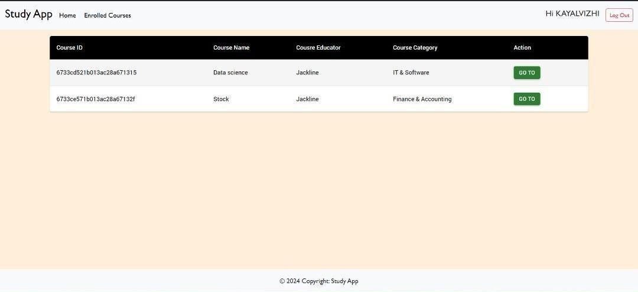

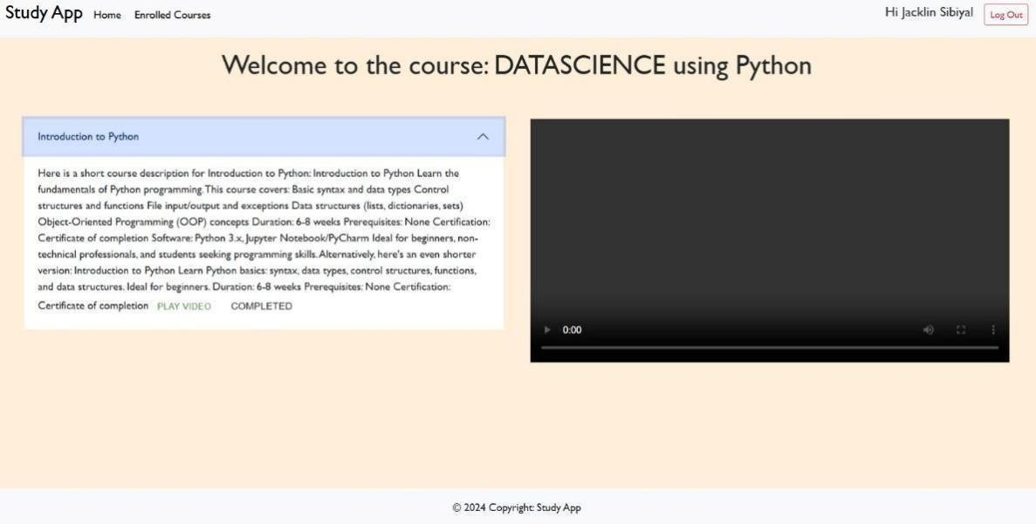
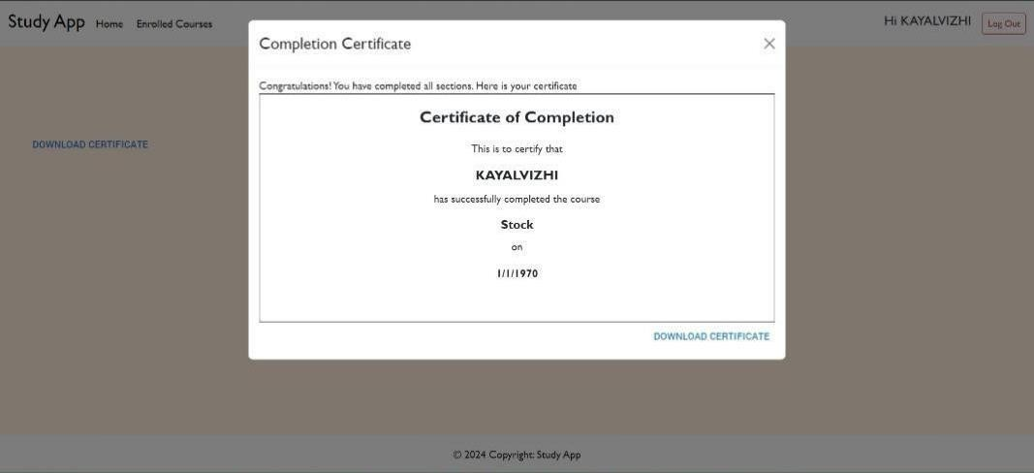
PROJECT EXECUTION SCREENSHOTS
These screenshots showcase key aspects of the project, such as the course listing page, the enrollment process, and the student dashboard.

Slide 16
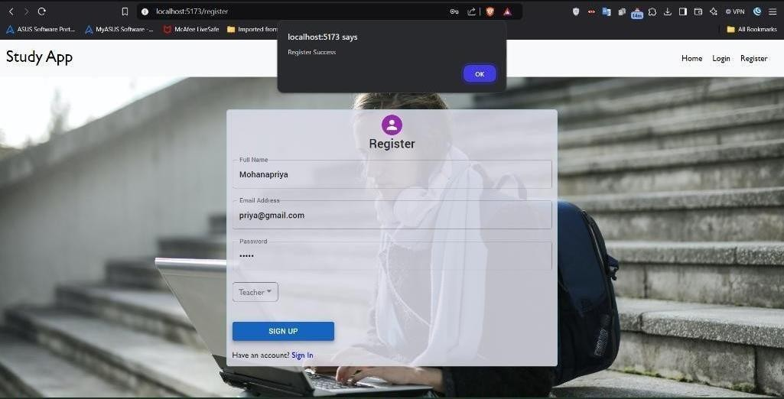
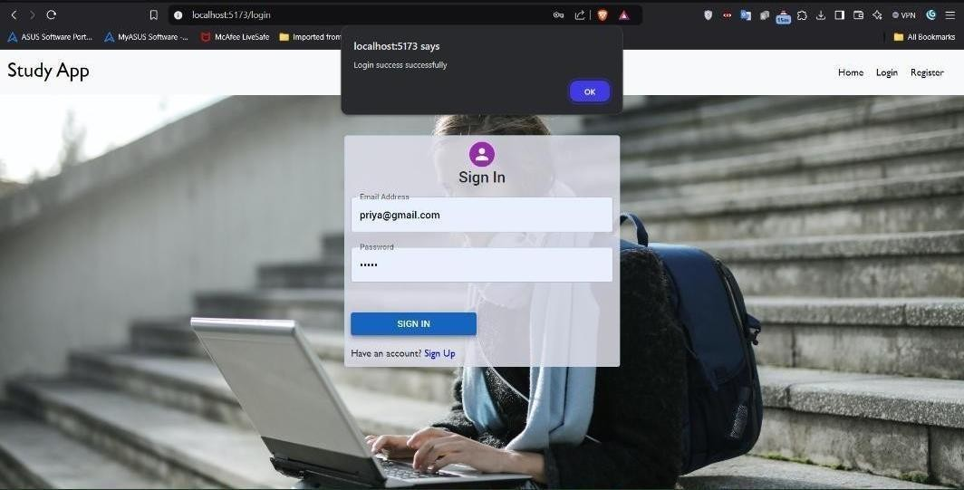
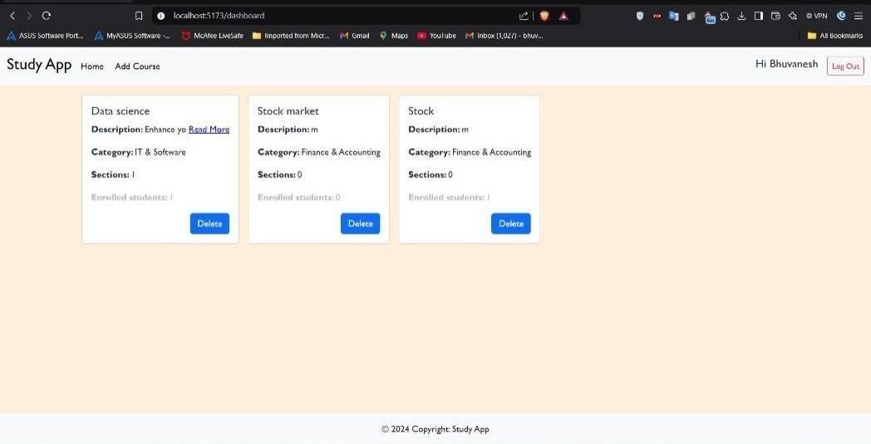
PROJECT EXECUTION SCREENSHOTS
These screenshots showcase key aspects of the project, such as the course listing page, Teacher login , Teacher’s course etc.

Slide 17
NEXT STEPS AND FUTURE ENHANCEMENTS
Expand Course Content
1
Offer a wider range of courses and subjects.
2
Integrate Gamification
Introduce interactive elements and rewards to enhance user engagement.
Implement AI-Powered Features
3
Utilize AI for personalized learning recommendations and automated assessments.
The team aims to continue improving the OLP by expanding its features, adding more courses, and integrating AI-powered functionalities to provide a more engaging and personalized learning experience.

Slide 18
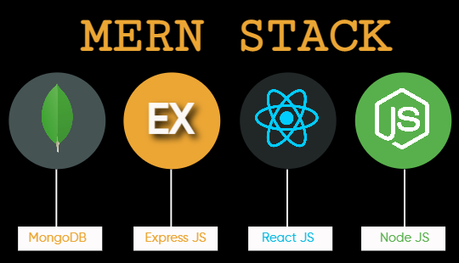
CONCLUSION
The OLP project demonstrates the successful integration of the MERN stack to create a robust and user-friendly online learning platform. By implementing modular code structure, secure authentication, and efficient data handling, this project provides a valuable tool for both students and instructors.
04

Slide 19


THANK YOU!

